Slide 1
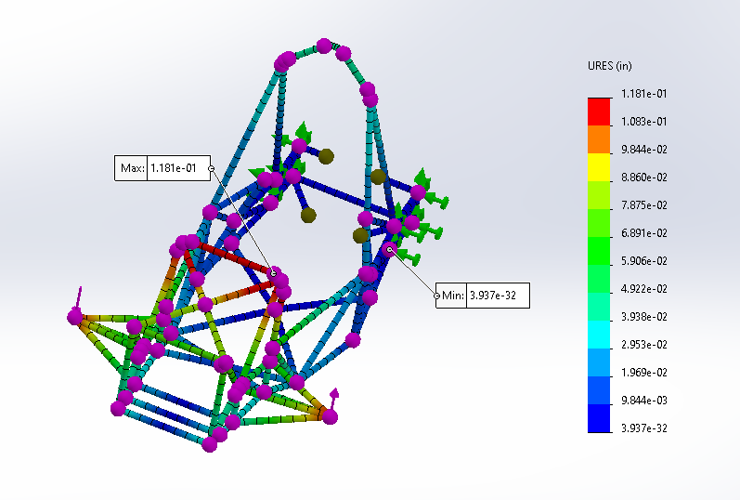
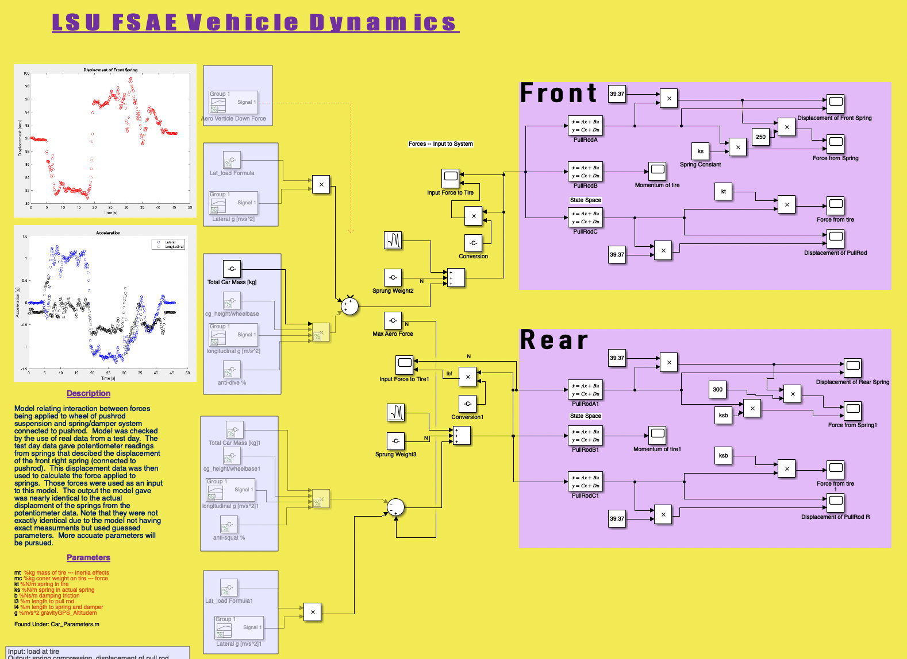
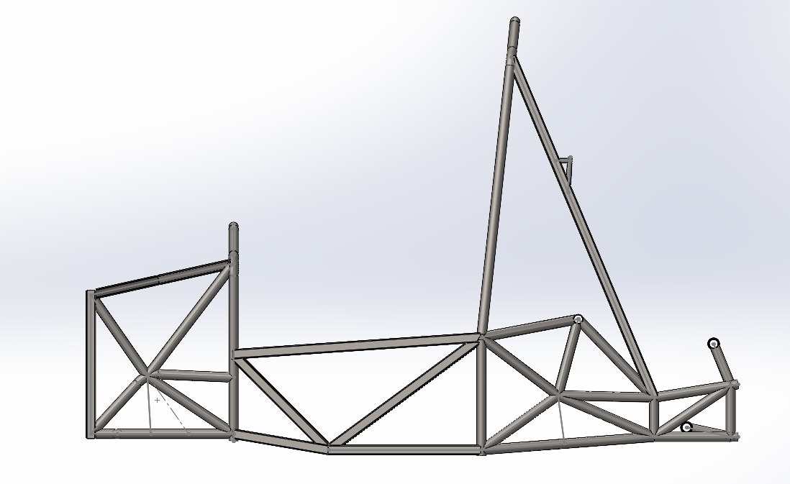
Chassis 2021-2022
Main Goals:
- Establish kinematics design and performance methodology
- Analyze current frame and look for possible improvements
- Fix the cause of brake failure at comp in Michigan
- Remanufacture front aero wing (look for ways to improve design)
Challenges:
- Corona handoff
- Young team
- Limited financially
- Shorter design period

Slide 2
Kinematics
Mason Pesson

Slide 3

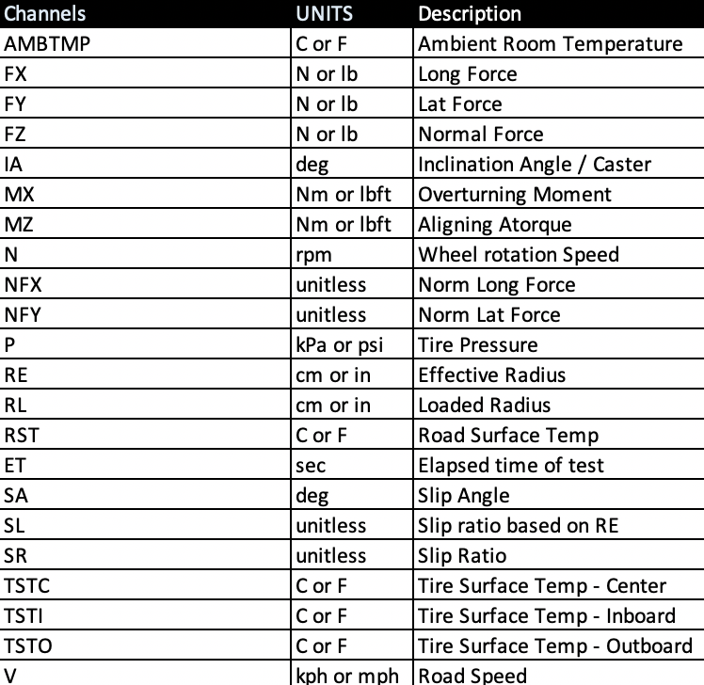
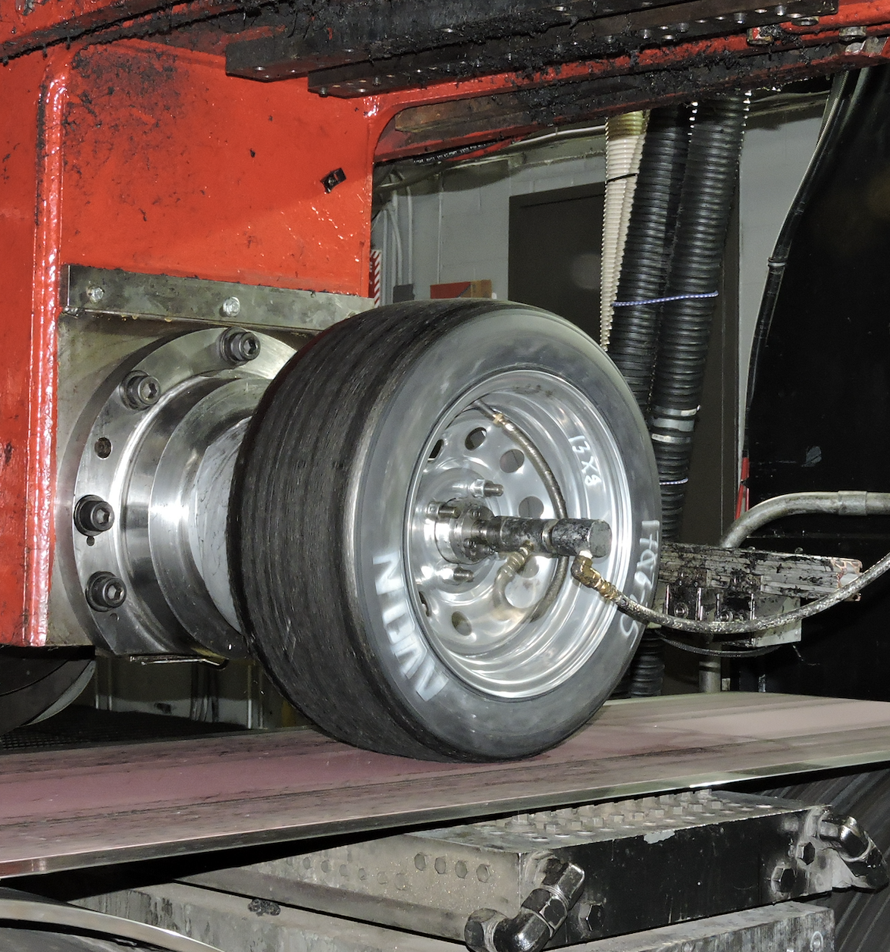
Tire Data Collection
Tire data is presented by Milliken Research Associates Incorporated on common tires used by FSAE teams. (Hoosier, Goodyear, Continental, Avon)
The data contains variables that define the performance of the tire under specific dynamic situation. All accessible variables can be found in the table below.
The data is collected at Calspans state of the art tire testing facility, shown in the picture below.
Although this data is collected by true professionals, it is important to recognize that there are still faults in the data.
The goal of using this data was to obtain an understand on the characteristics of the tire, so an optimized suspension system could be designed and modified for given road conditions.

Slide 4
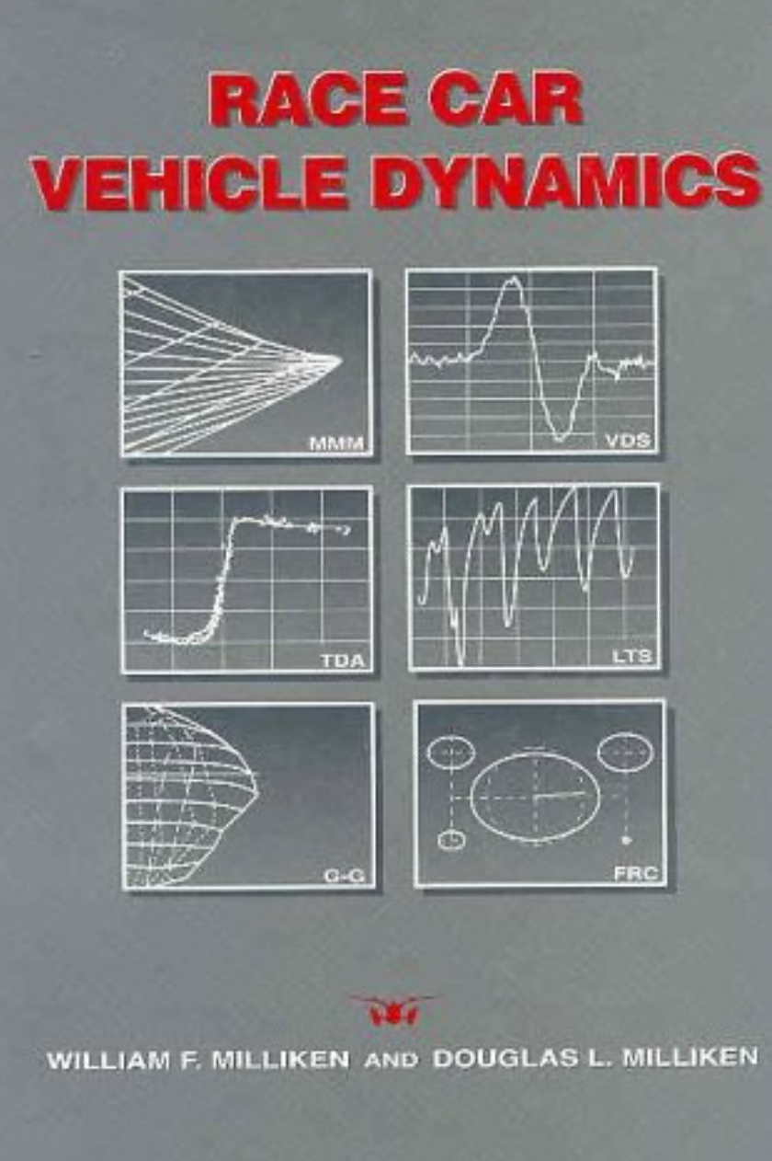
Studying The Data
In order to get the most out of the data requires an understanding on the interaction between different variables found in the table on the previous page.
In a general since, your goal is the following:
How can I optimize the tires ability produce lateral and longitudinal forces without exceeding its range of elastic deformation?
If I optimize the above performance, how will it affect the rest of the vehicle?
Goal number 1 can be accomplished by studying the relationship between a tires slip angle with lateral force & slip ratio with longitudinal force, while changing inclination angle, tire pressure and normal force.
Goal 2 requires a model of the vehicle

Slide 5
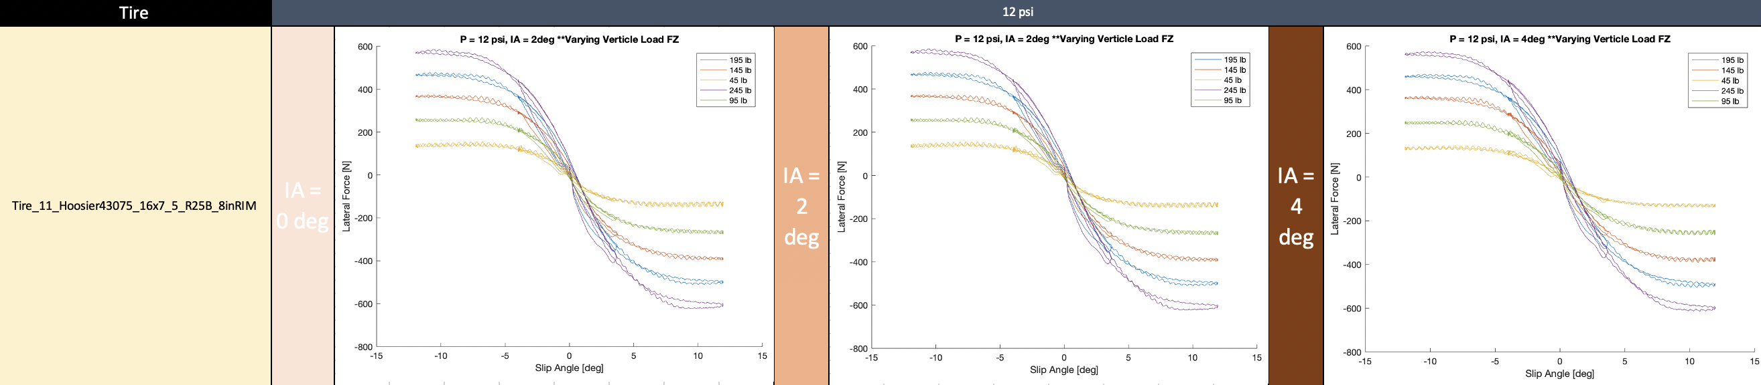
Organizing the Data
Multiple MATLAB code were produced in order to efficiently extract the data.
The output of these codes were then formatted and posted into an excel for correct documentation
Main Outcomes:
Design Criterion:
Tires produce max lateral force at a given slip angle with zero camber
Maintenance Criterion:
Ability to scale the tire pressure to understood levels for different dynamic event

Slide 6
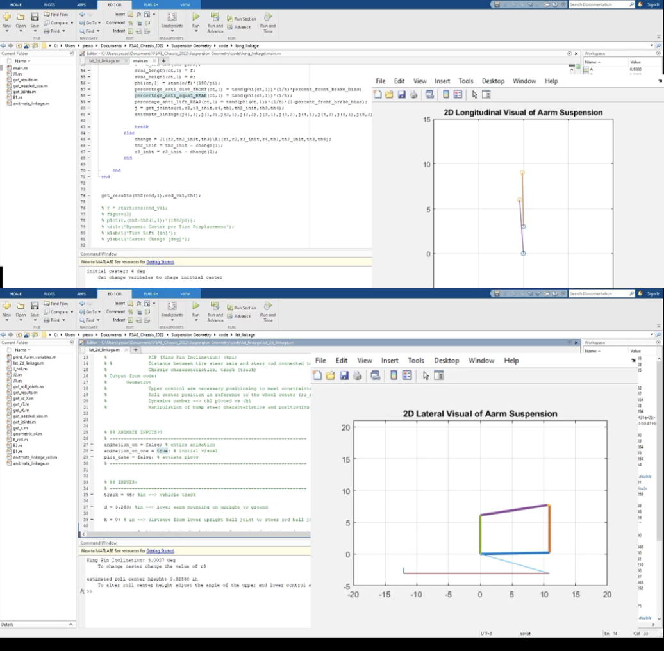
Modeling The Vehicle
- If the goal is to keep the tire at zero camber to maximize lateral forces then how can this be accomplished?
Need a model of the vehicle

Slide 7
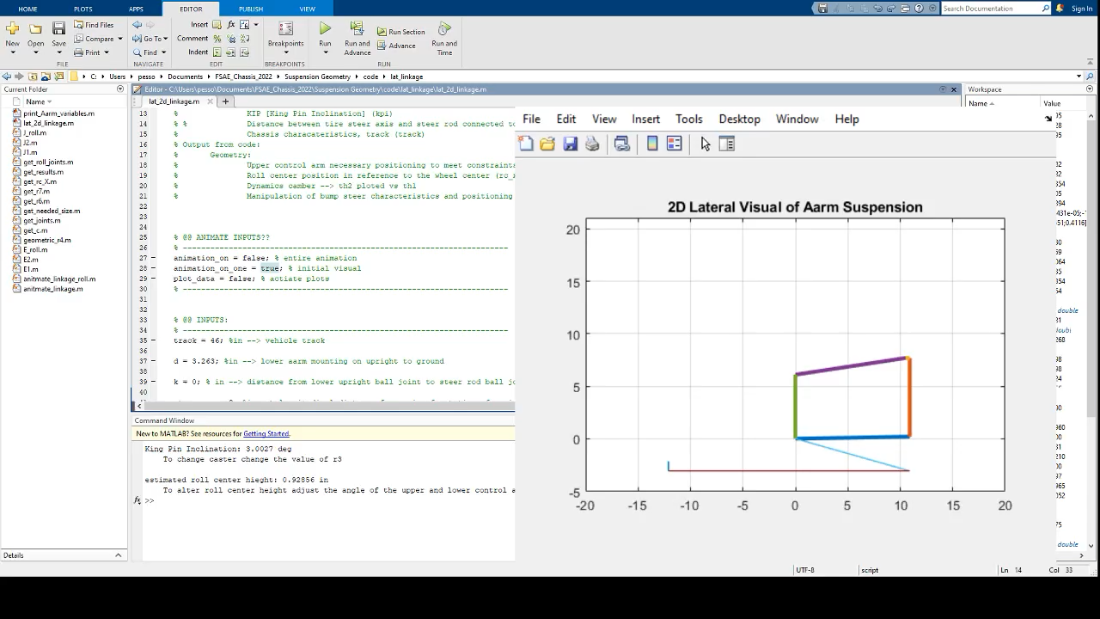
Lateral Model
Output from model:
- Necessary control arm positioning in reference to the frame and tire
- Roll center position in reference to the wheel center
- Dynamic Camber
- Manipulation of bump steer from positioning of toe rod

Slide 8
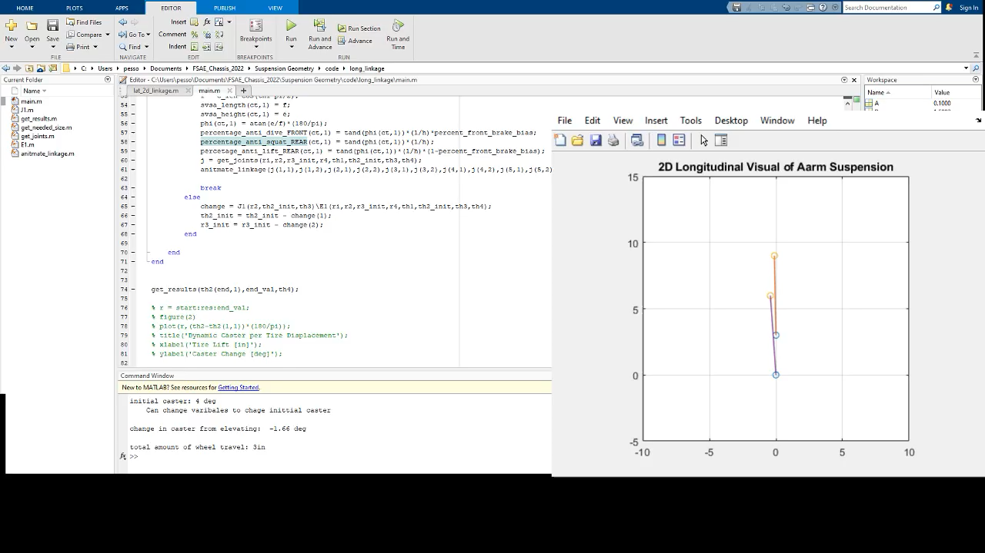
Longitudinal Model
Output from model:
- Effects that tire displacement have on dynamic caster
- Percentage anti-dive, anti-squat, and anti-lift

Slide 9
Dynamic Model
Output from model:
- Displacement of spring and tire due to a specified dynamic lateral load, longitudinal load, and aero downforce. Takes into account anti-effects, suspension components i.e. the torque converter between the shocks and tires.
- Tested with actual data obtained from potentiometers mounted on vehicle

Slide 10
Frame
Mason Pesson

Slide 11
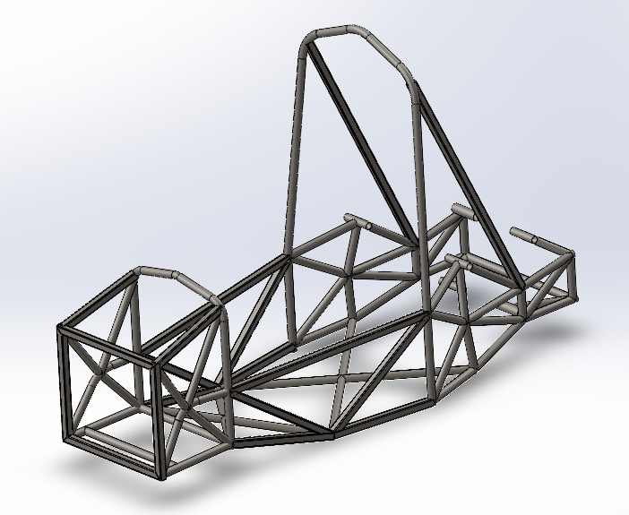
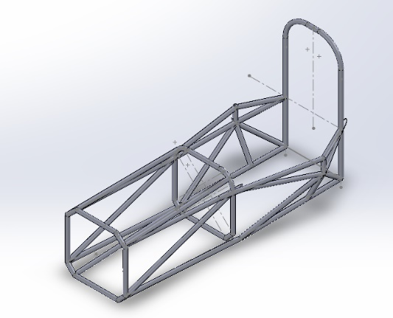
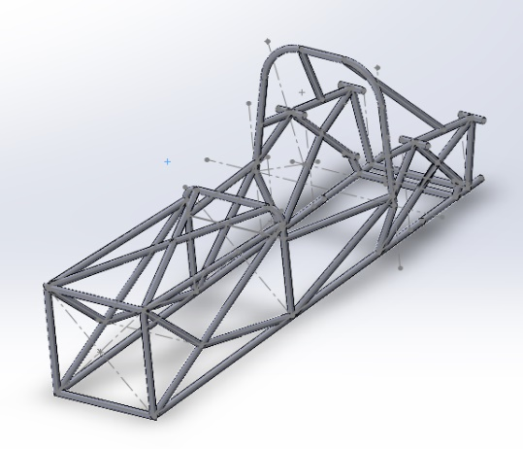
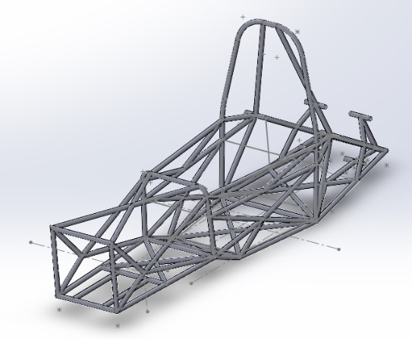
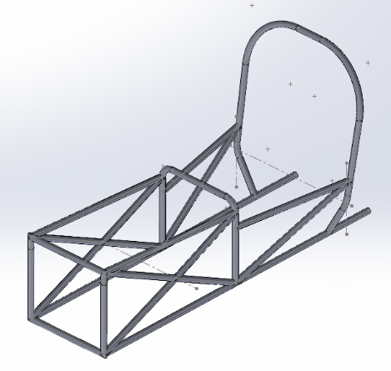
The Programming Approach
With over 100 pages of rules, an SES that needed to be followed and also needing to learn why the chassis is the way it is today - Where do you start?
Answer: Begin failing and then fail some more.
- A total of 10 iterations were designed, each one learning from the next.
Main takeaways:
CG
Space distribution
Optimizing Solidworks (setup for easy design work)

Slide 12
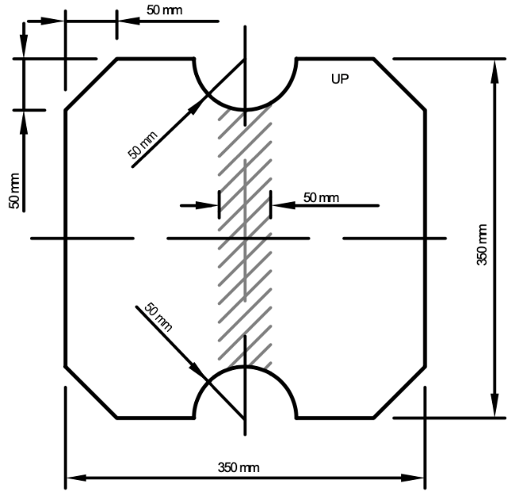
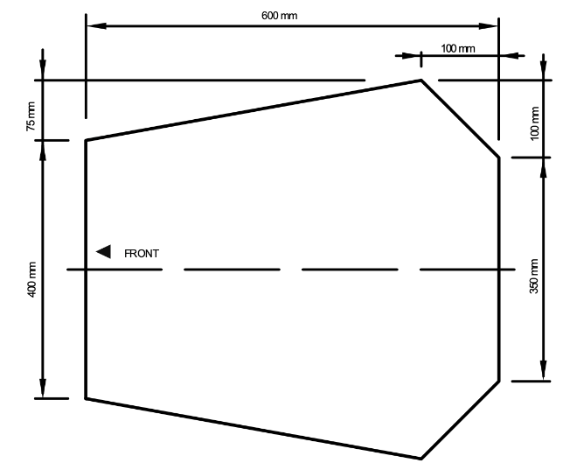
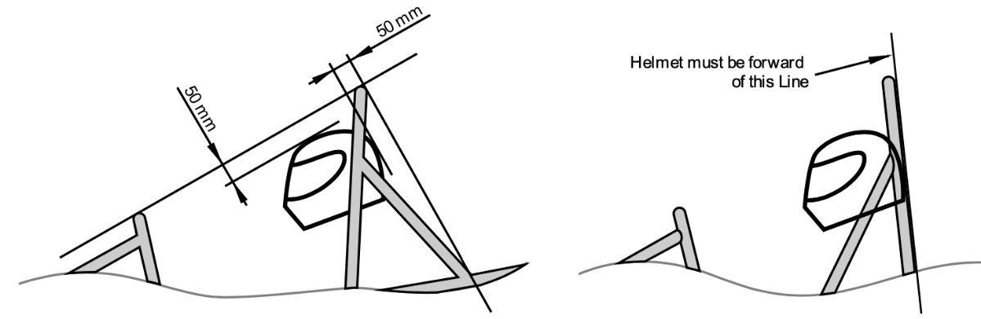
Weight Reduction due to Space Requirements
If you decrease the size of the car then you will decrease the amount of tubing used
Usually do not have the ability to do this because you are just making frame fit the suspension

Slide 13
Outcome
A frame that weighed 10 lbs lighter & was only approximately 100 Nm/deg less stiff than the original frame.
HOWEVER: To completely remake a competing frame for the 2021-2022 season is a big decision. There is a lot to consider:
- Collision testing (What happens to frame during crash)
- New driver position problems
- Aerodynamics mounting
- Suspension constraints (no collision of moving linkages)
- Driver comfort
- The COST of these potential issue (can’t financially afford to be wrong)

